Slide 1
3
MUHAMAD DANI SETIAWAN
Re CAPTCHA on
Google
KAPTEN BINTANG

Slide 2

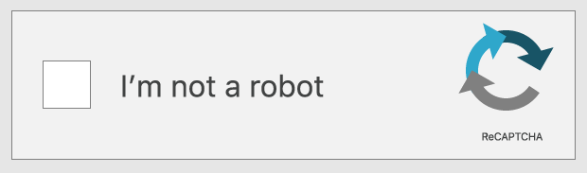
RECAPTCHA
What is reCAPTCHA
CyberSecurity
Why is reCAPTCHA made for

Slide 3
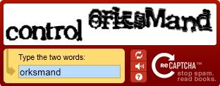
HOW DOES reCAPTCHA WORKS ?
Text Verification
CheckBox
Image Verification

Slide 4
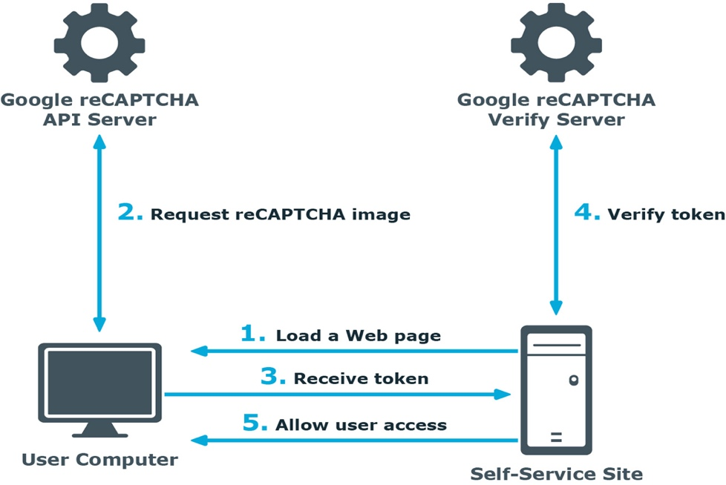
ARCHITECTURE ON RE CAPTCHA

Slide 5
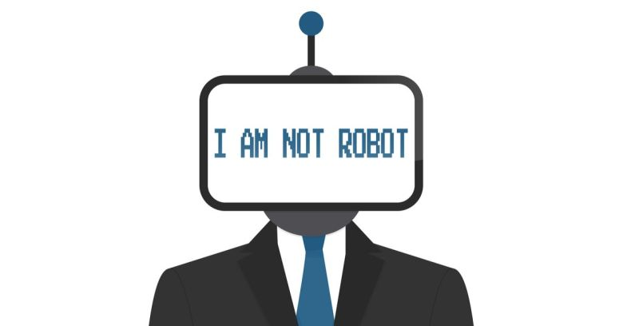
Advantages and Disadvantages of using re CAPTCHA
Advantages
Distinguishes between a human and a machine
Makes online polls more legitimate
Reduces spam and viruses
Makes online shopping safer
Diminishes abuse of free email account services
Disadvantages
Sometimes very difficult to read
Are not compatible with users with disablilities
Time-consuming to decipher
Technical difficulties with certain internet browsers
May greatly enhance Artificial Intelligence

Slide 6
The Different CAPTCHA and reCAPTCHA
Captcha, if the captcha is taken from a random word but the purpose is the same as recaptcha which is to avoid spam bots
reCAPTCHA, if recaptcha, words taken using words from a digital book project and compiled using OCR.

Slide 7
DEMO if the user uses a connection bot on the web that is used recaptcha

Slide 8

CONCLUSION
Unfortunately, as bots get more and more advanced, reCAPTCHA methods will have to become more and more intrusive to establish that you are in fact human. Users will need to sacrifice more of their privacy in order to remain safe from spam and bots on the internet, and by the looks of things, it’s something we’ve got to accept.

